Slide 1
An Introduction to
Site-Level
Quality Management within
the Clinical Research Process
CROMS
NIDCR
Clinical Research Operations and Management Support
Rho, Inc., Federal Division
National Institute of
Dental and Craniofacial Research
National Institutes of Health

Slide 2
Quality Management (QM) Definition and Levels of Involvement
The overall process of establishing and ensuring the quality of processes, data, and documentation associated with clinical research activities.
Quality Management (QM) occurs at multiple levels of the clinical research process: sponsor level, external clinical monitoring level, study level, and individual site level.

Slide 3
Objectives of this Presentation
The primary purpose of this presentation is to clarify Quality Management as it relates to site-level documentation, processes, and activities.
The secondary purpose is to clarify tools that are available to support site-level QM.

Slide 4
Objectives of Quality Management
When QM activities are implemented, a standard of data integrity and proper study conduct is established
QM includes BOTH processes aimed at prevention of errors as well as those associated with detection and correction of errors
Proactive prevention of errors means less time and money is required to correct errors downstream

Slide 5
Why Do Errors Occur at any Stage of Clinical Research?
Insufficient written procedures
Written procedures not followed
Training not done or incomplete
Lack of ongoing checks to assess errors
Individual roles and responsibilities are unclear or undefined
Notes:
Quality Management plans focus on these aspects of research to ensure quality.

Slide 6
Components of
Quality Management
Quality Management includes two main
components:
Quality Control
Quality Assurance
Quality Management
Notes:
Among industries and even within the clinical research industry there are multiple, sometimes discordant, definitions of quality control and quality assurance. The following definitions have incorporated concepts from formal sources (e.g., ICH and ISO 9000), but have been customized for clinical site application. Definitions have been provided for purposes of completeness. Please note that ensuring sufficient quality management activities exist and are being properly executed is even more important than the classification of those efforts. Studies need an overall quality management strategy that includes written procedures, ongoing verification of documentation, and additional review of compliance with written procedures/guidelines/regulations.

Slide 7
Quality Control (QC) Definition
A set of operational activities intended to ensure the quality requirements are actually being met. It is the ongoing review of data collection forms and other records for completeness and logic.

Slide 8
QC Examples
Relevant site staff activities would include, but not be limited to:
  Completion of checklists to confirm the appropriateness of each subject’s informed consent process
  Systematic comparison of the electronic (or paper, if applicable) clinical data to the medical records or other source documentation
  Ongoing review of the contents of the Essential Documents Binder (a.k.a. Investigator Site File/Binder) for completeness
  Maintaining temperature logs on specimen storage freezers

Slide 9
Quality Assurance (QA) Definition
A set of activities intended to a) establish quality requirements and procedures; b) ensure that those requirements are being met and procedures followed; and c) verify that quality is being maintained.
This includes the generation of procedural documents to guide quality activities and the review of documentation to assess adherence to written procedures, policies, and regulations.

Slide 10
QA Examples
Relevant site staff activities would include, but not be limited to:
  Creation of written Standard Operating Procedures (SOPs) describing step-by-step activities associated with a particular aspect of protocol execution
  Review of completed or partially completed checklists of QC activities to confirm that an established quality process is being followed
  Review of training logs to ensure that sufficient and relevant training has been appropriately completed and documented
Notes:
“The development and use of SOPs are an integral part of a successful quality system as it provides individuals with the information to perform a job properly, and facilitates consistency in the quality and integrity of a product or end-result. The term “SOP” may not always be appropriate and terms such as protocols, instructions, worksheets, and laboratory operating procedures may also be used.” –EPA Guidance for Preparing Standard Operating Procedures section 1.1

Slide 11
Preparing a Clinical Quality Management Plan
The Clinical Quality Management Plan (CQMP) establishes the quality management guidelines for tasks related to a specific clinical study at a particular clinical site.
The purpose of the CQMP is to identify the processes and activities that will be used to monitor and facilitate quality protocol execution.
This CQMP is a living document, reviewed on a regular schedule, and updated, as needed, to ensure continued or improved quality management.
CQMP Template is/will be available on the NIDCR Toolkit for Clinical Researchers
Notes:
Tools are also currently available on the NIDCR-CROMS website in the Quality Management folder of the Clinical Toolbox.

Slide 12
Additional Quality Management Tools
Quality Management of Clinical Research-Brief Overview — a high level summary, synthesizing the content from these slides
Quality Management Subject/Participant Data Review Tool — a checklist to facilitate the quality review of individual subject data and information
Quality Management Study-wide Review Tool — a set of suggested items to facilitate quality review of the Essential Documents Binder and other study-wide items
Quality Management Summary Report (template) — a report that summarizes the findings of quality reviews of study data and processes and makes recommendations for improvements
Notes:
The following QM tools/templates are/will be available in the NIDCR Toolkit for Clinical Researchers as well as in the Clinical Tool Box (“Quality Management” folder) on the NIDCR-CROMS website. Each tool includes a Summary Sheet that provides further details and suggested best practices for use. Also included within the body of these tools is additional instructional and/or sample text. Users should customize these templates to meet the needs of the study.

Slide 13
Storage of QM Materials
All Quality Management Checklists, Plans, Completed Tools, and Reports should be stored in a Quality Management Binder, which is maintained separately from the Essential Documents Binder

Slide 14
Quality Management
Any questions?

Slide 15
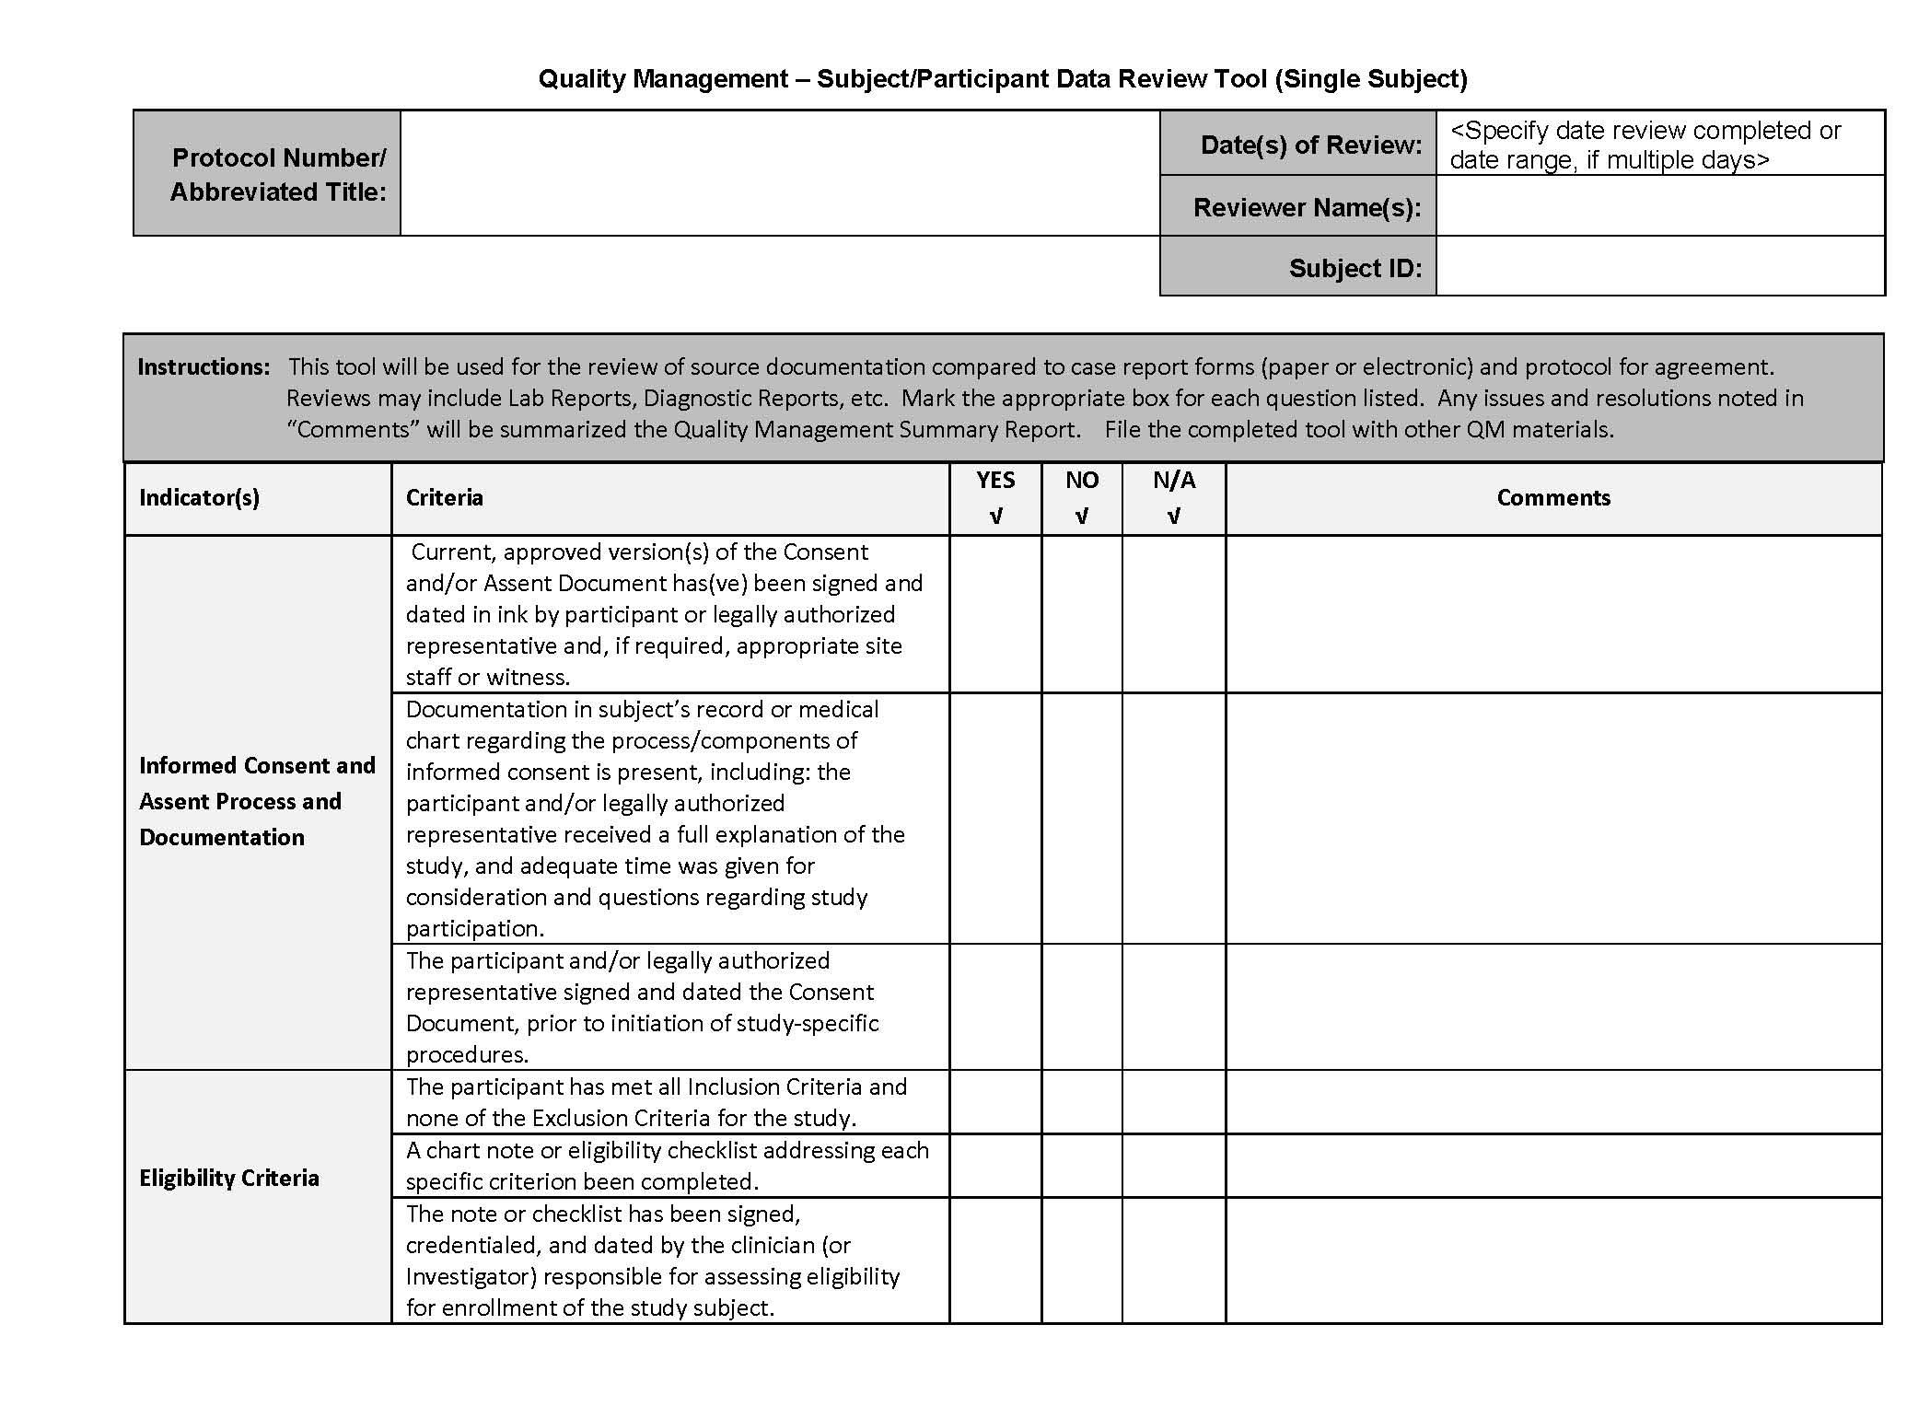
Notes:
This is a sample checklist. It is linked to from page 12.

Slide 16
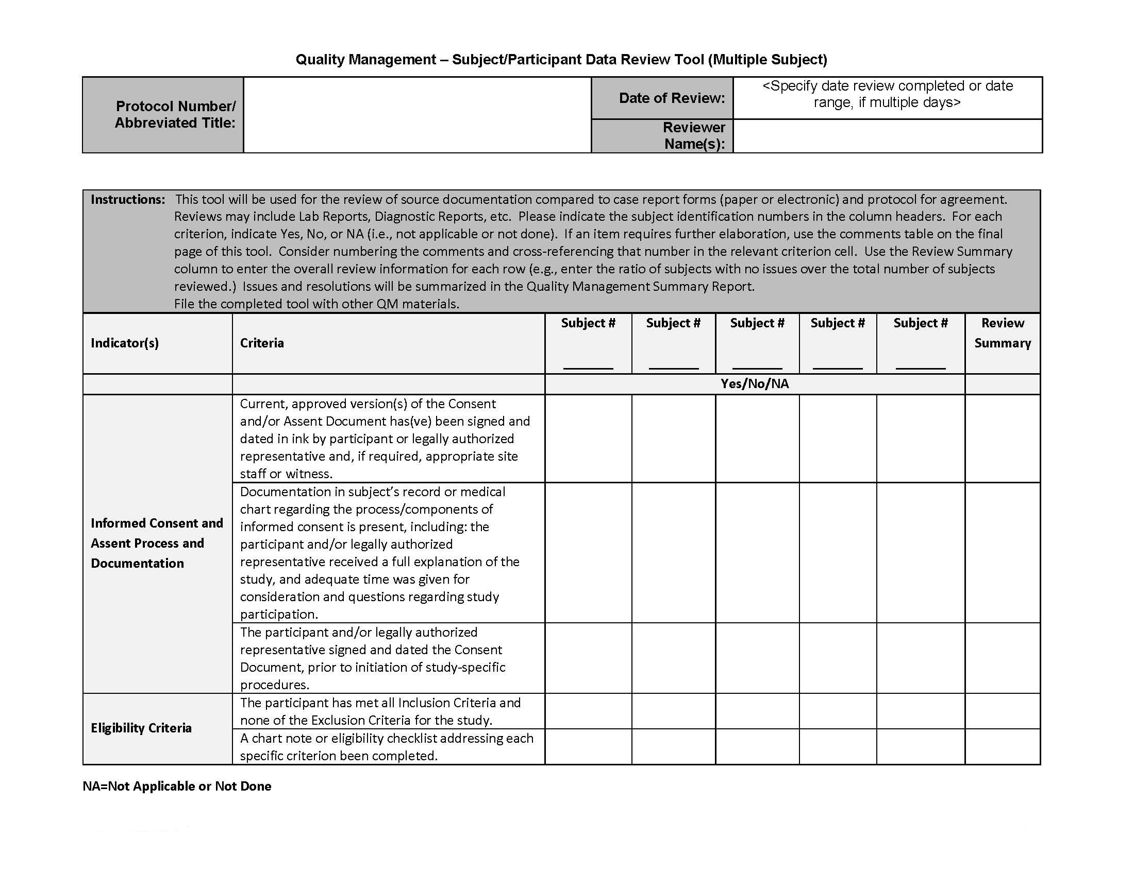

Slide 17
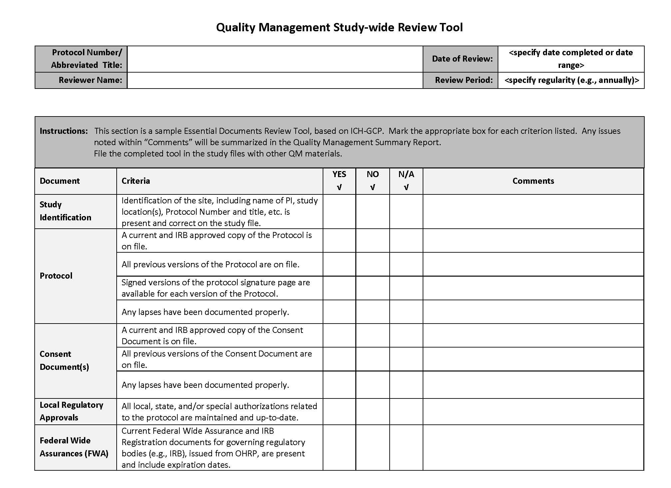
Notes:
This is a sample checklist. It is linked to from page 12.

Slide 18
