Slide 1


A world of opportunity in dental research
The National Institute of Dental and Craniofacial Research,
National Institutes of Health (NIDCR/NIH)
© ra2 studio/Shutterstock.com

Slide 2

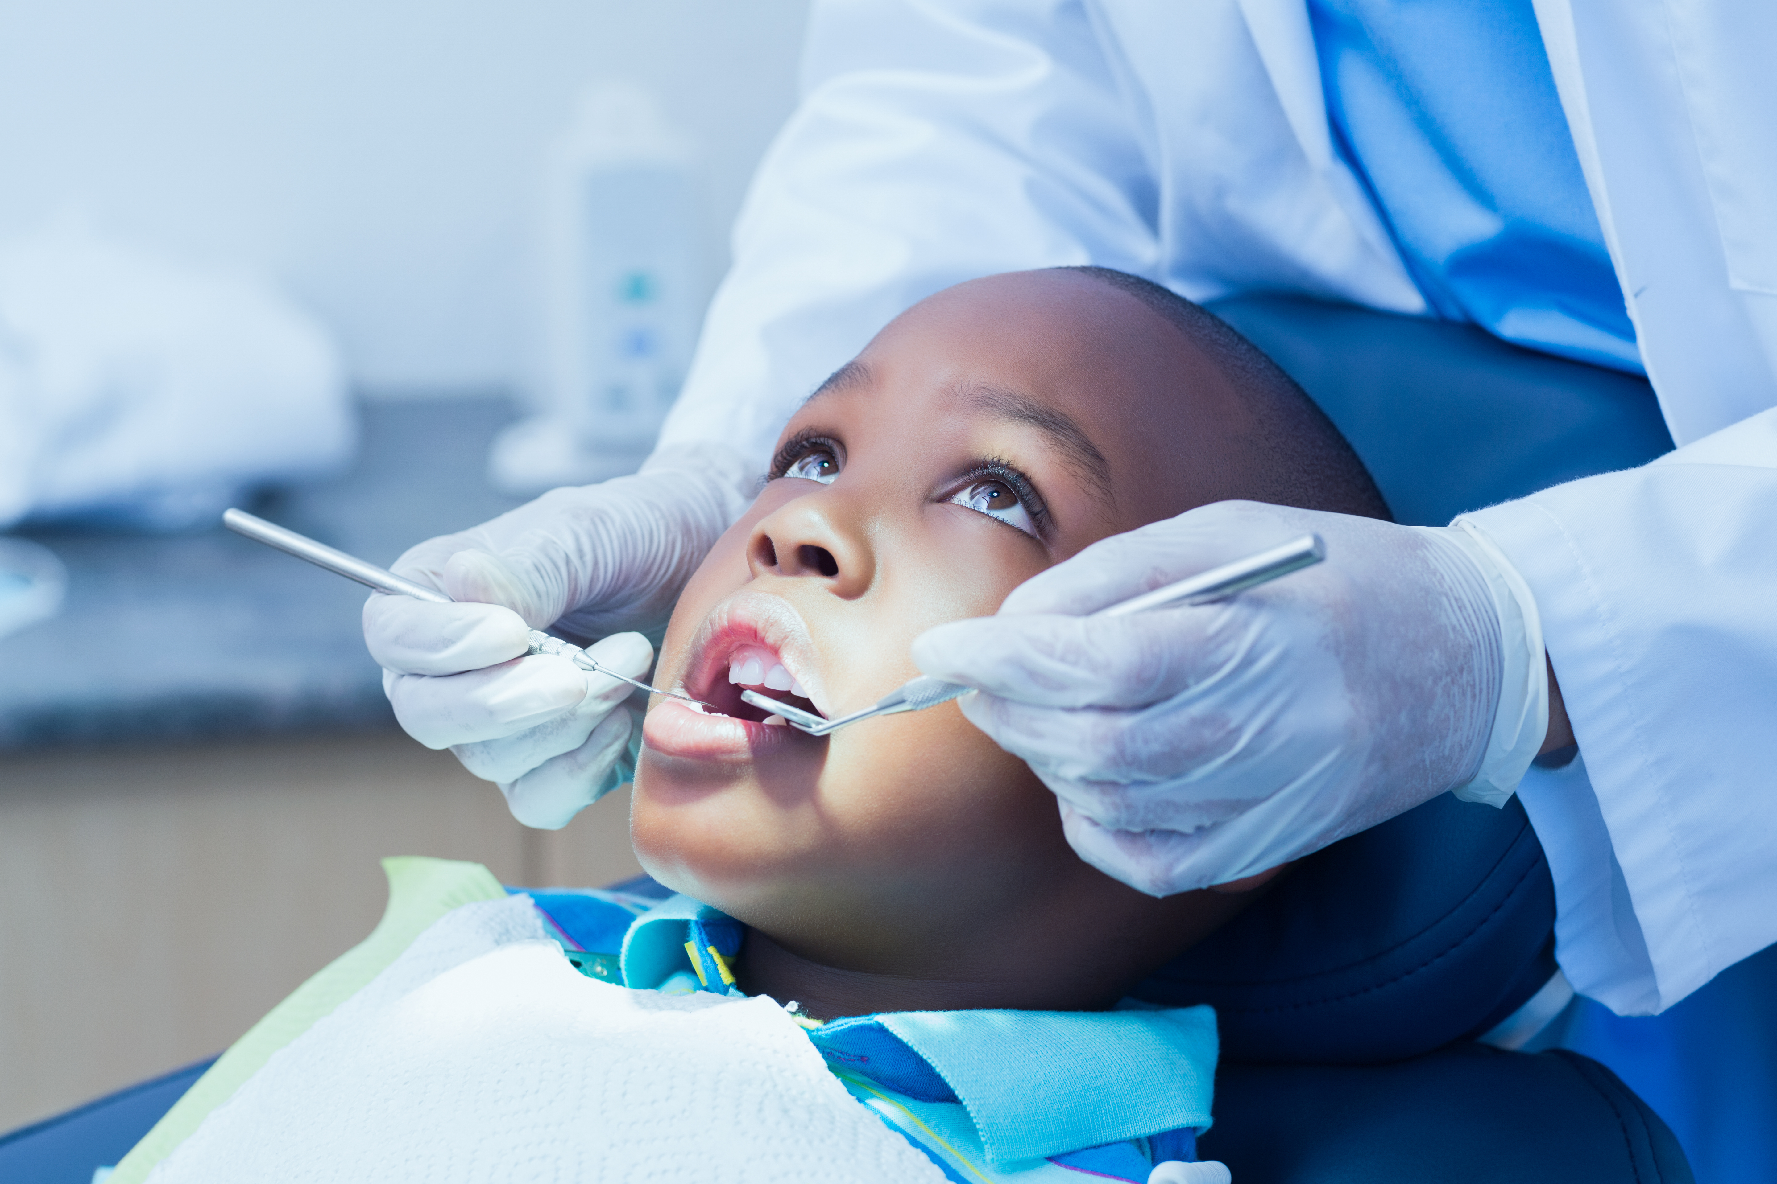
In this presentation
Meet Jennifer
Talking points
Researchers investigating risks and causes of oral health problems…
Talking points
Researchers investigating ways to correct oral health problems…
Talking points
Researchers investigating wider impacts of oral health…
Talking points
Pathway from school to dental research
Explore careers in dental research
More resources
© wavebreakmedia/Shutterstock.com
02

Slide 3
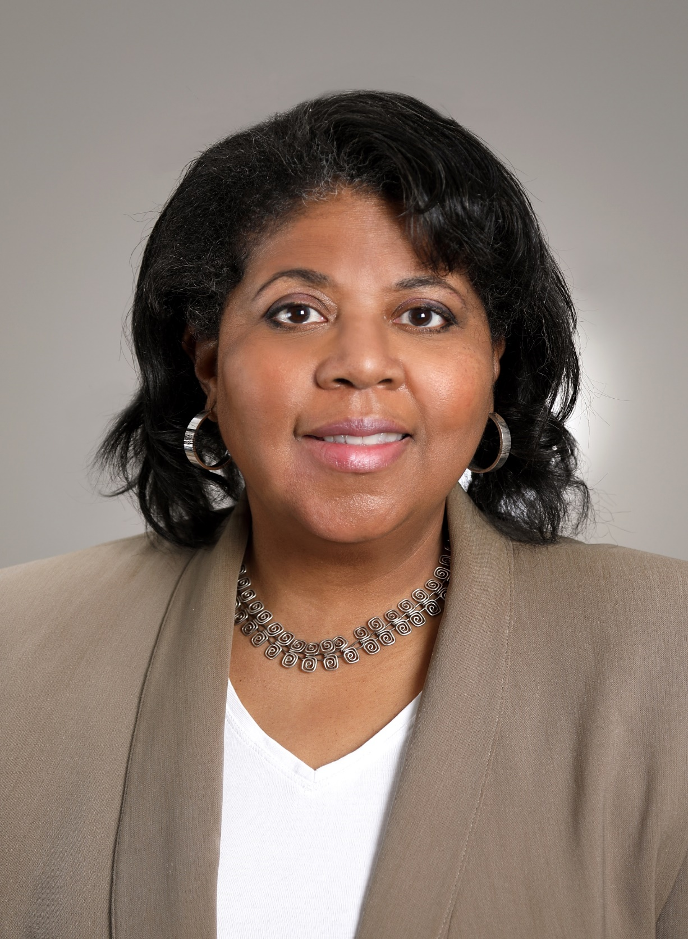


Meet Jennifer
Deputy Director, National Institute of Dental and
Craniofacial Research, National Institutes of Health, Maryland, USA
Fields of research
Oral Health, Microbiology, Immunology, Virology
Jennifer explains the opportunities available for the next generation of dental researchers…
Dr Jennifer
Webster-Cyriaque
03

Slide 4
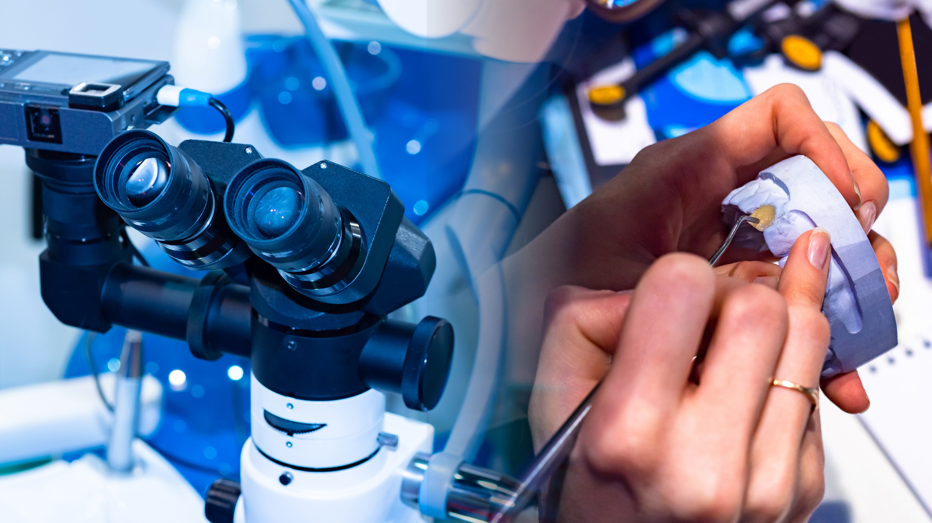
Dentistry is about more than a bright smile…
“Oral health is important because without it, we cannot be truly healthy.” – Jennifer
Oral diseases are highly prevalent. 90% of people in the world are affected by oral disease, including caries (cavities), gum disease, cancers, genetic disorders (including cleft lip and palate), and autoimmune diseases.
“Dental research focused on understanding how best to prevent oral disease and on understanding the relationship between oral disease and systemic disorders will lead to significant improvement.”
04
© FOTOGRIN/Shutterstock.com

Slide 5
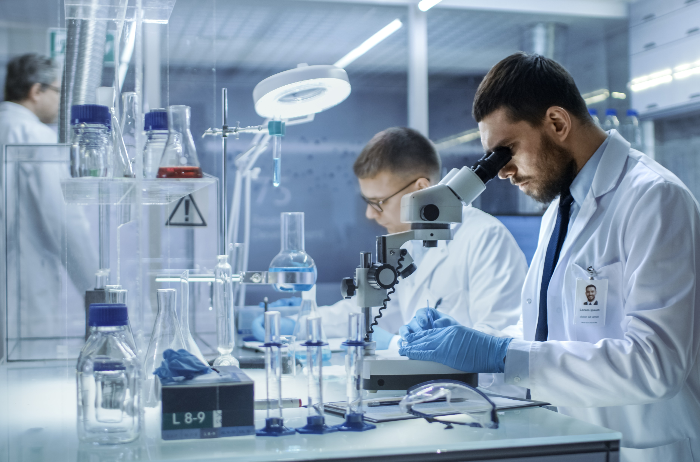
The future of dental research
There are challenges to overcome but also many advancements to build upon.
“For example, artificial intelligence is being used to diagnose oral cancers, while microbots made of nanoparticles are being used to brush and floss teeth.” – Jennifer
It is a fascinating time to be entering the world of dental research, where data science and computational tools are being used to look at ‘big data’, answering important questions in oral health.
“New technologies are supporting dental researchers in their work. More people will keep their teeth, have viable replacement teeth and benefit from a healthy oral environment. Working in dental research is incredibly rewarding, and we look forward to you joining us!”
05
© Gorodenkoff/Shutterstock.com

Slide 6

Talking points
How prevalent (common) are oral diseases around the world?
What impact could new technologies have on oral health?
What do you think are the rewards of a career in dental research?
How likely are you to consider a career in dental research, and why?
06
© ra2 studio/Shutterstock.com

Slide 7
Researchers investigating risks and causes of oral health problems…
07
© ra2 studio/Shutterstock.com

Slide 8
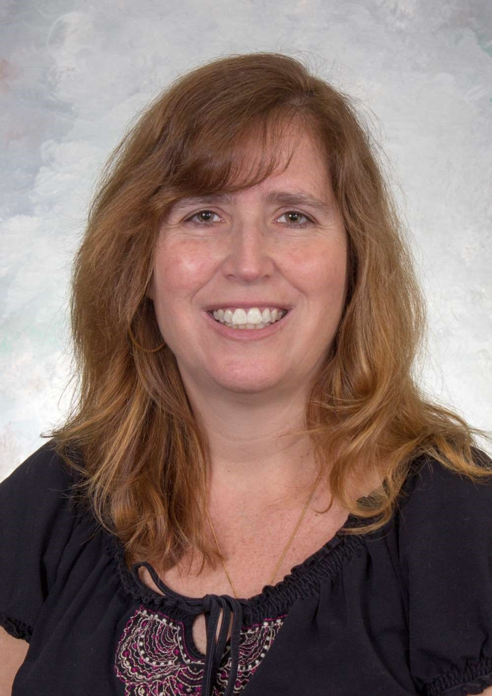
Meet Margherita
Clifford Nelson Endowed Professor and Professor of
Dentistry Director, Global Initiatives Program in Oral and Craniofacial Health, Department of Cariology, Restorative Sciences & Endodontics, University of Michigan School of Dentistry, USA
Field of research
Cariology
As a cariologist, Margherita researches tooth decay. Currently, she is conducting clinical studies to investigate caries risk in young children.
Learn more about Margherita’s work…
Dr Margherita
R. Fontana
08

Slide 9
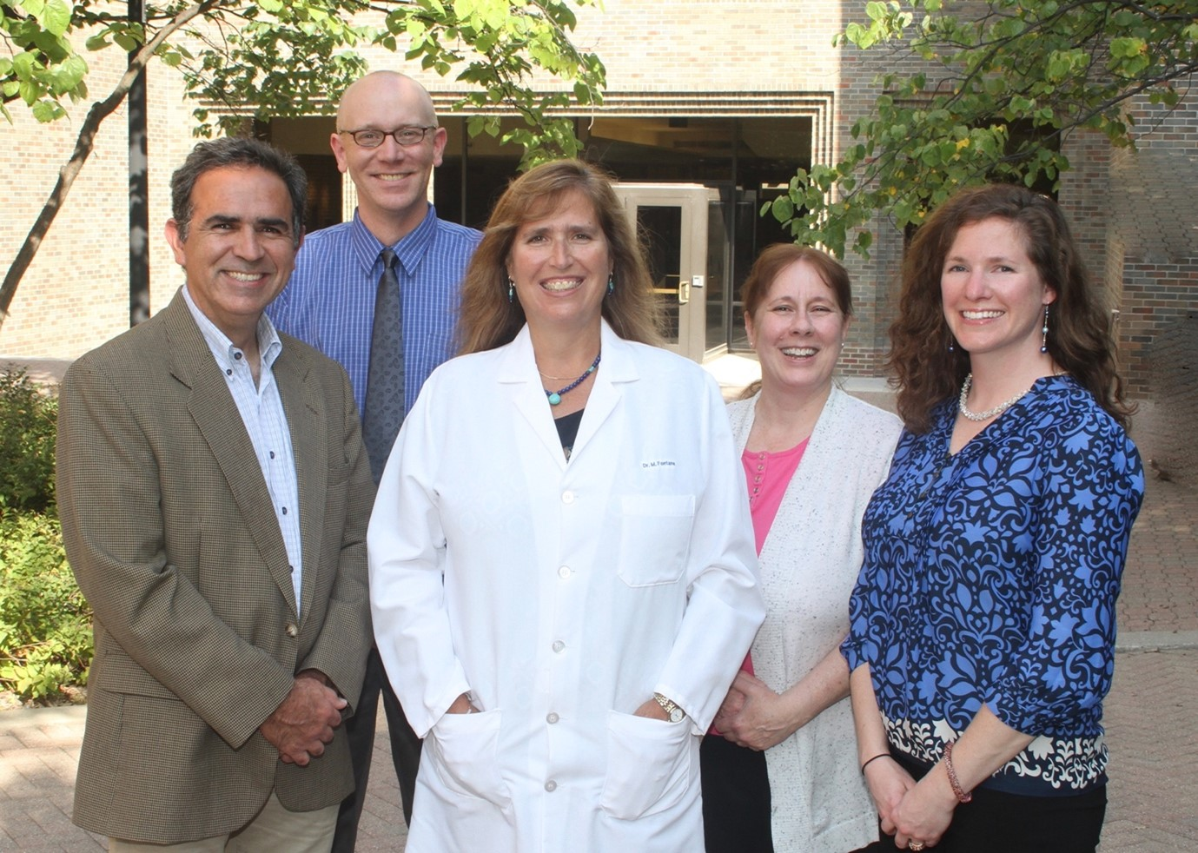
Margherita’s research
“We have developed caries risk tools for early childhood and are now focusing on the school age years into early adolescence.
“We are conducting in vitro studies of biofilms. Chemical and biofilms caries models are important to understand how biofilms react with tooth surfaces and how cavities develop in response to different conditions.
“A career in cariology relies on many years of study, but it is very rewarding. I have been able to collaborate with wonderful communities of people in different parts of the world, all committed to improving the health of children worldwide..”
Dr Margherita R. Fontana (center) and colleagues.
09

Slide 10
Margherita says…
“What one word sums up a career in cariology? Impactful
My top tip:
Follow your dreams and take advantage of opportunities as they happen in life.”
Dr Margherita
R. Fontana
10

Slide 11
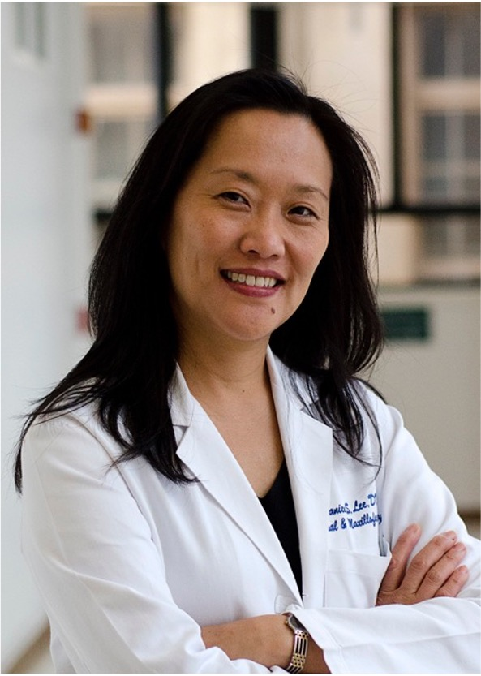
Meet Janice
Clinical Director, Craniofacial Anomalies and Regeneration Section, NIH National Institute of Dental and Craniofacial Research, Maryland, USA
Field of research
Craniofacial Anomalies and Regeneration
Janice is a surgeon scientist. She leads
the Lee lab, focusing on craniofacial
research.
Learn more about Janice’s work…
Dr Janice Lee
11

Slide 12

Janice’s research
“Currently, my lab is studying skeletal malocclusions (severe underbite and overbites) to understand the genetics and shape changes, so we can predict who will develop the condition.
“Using 3D computational analysis, we examine craniofacial development and compare the differences in healthy groups and individuals with specific diseases.
“My research enables me to understand the condition in more detail, informs earlier diagnosis and predicts craniofacial development. To do this, my research relies on a strong partnership with patients who contribute their time, data and experience to help me find answers.”
© Gorodenkoff/Shutterstock.com
12

Slide 13
Janice says…
“What one word sums up a career in craniofacial research? Fulfilling
My top tips:
It’s never too early to talk to clinician-scientists who are doing what you find interesting.
Explore and find what excites you the most… then work doesn’t feel like work.”
Dr Janice Lee
13

Slide 14
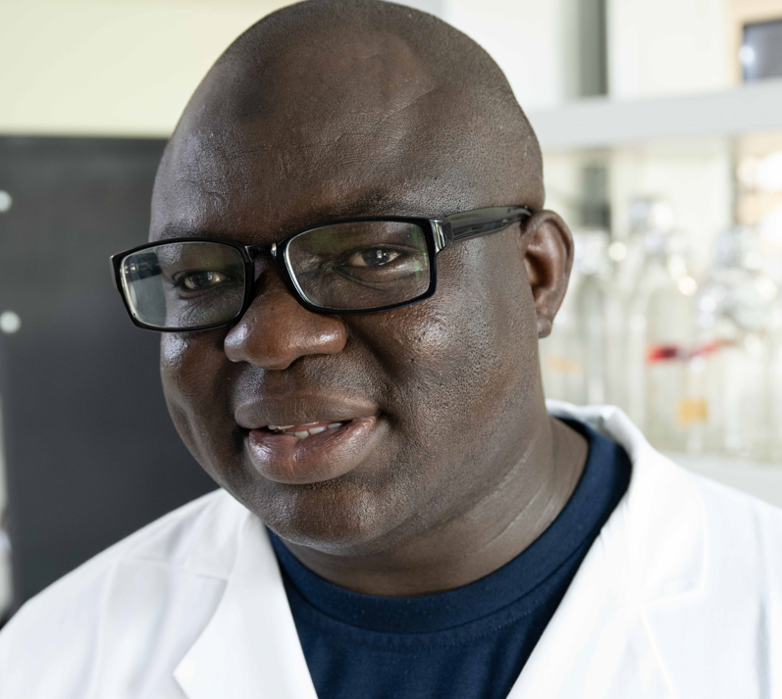
Meet Azeez
Gilbert Lilly Endowed Professor of Diagnostic Sciences, College of Dentistry, University of Iowa Health Care, USA
Fields of research
Genetics, Genomics and Ethical, Legal and Social Issues (ELSI)
A researcher in dental and craniofacial genetics, Azeez also directs the African Craniofacial Anomalies Network.
Learn more about Azeez’s work…
Dr Azeez Butali
14

Slide 15
Azeez’s research
“My research has included looking at non-syndromic clefts – a birth defect where the nasal and oral cavities have not divided completely – in populations of African descent.
“The African Craniofacial Anomalies Network is a collaboration between scientists in Ghana, Ethiopia, Kenya, Nigeria and Rwanda. We aim to train and build capacity in Africa for research into dental and craniofacial diseases, to investigate the genetics and environmental causes of dental and craniofacial diseases, and to create opportunities for transdisciplinary and global research.
“Genetics is a rapidly evolving field, and there is need for constant training and retraining to keep abreast with the dynamic research environment.”
15

Slide 16
Azeez says…
“What phrase sums up a career in dental and craniofacial genetics? Be intentional
My top tips:
Trust the journey, focus on the clinical skills, and aspire to become the best dental scientist that you can be.
Open yourself up for learning and mentoring.”
Dr Azeez Butali
16

Slide 17
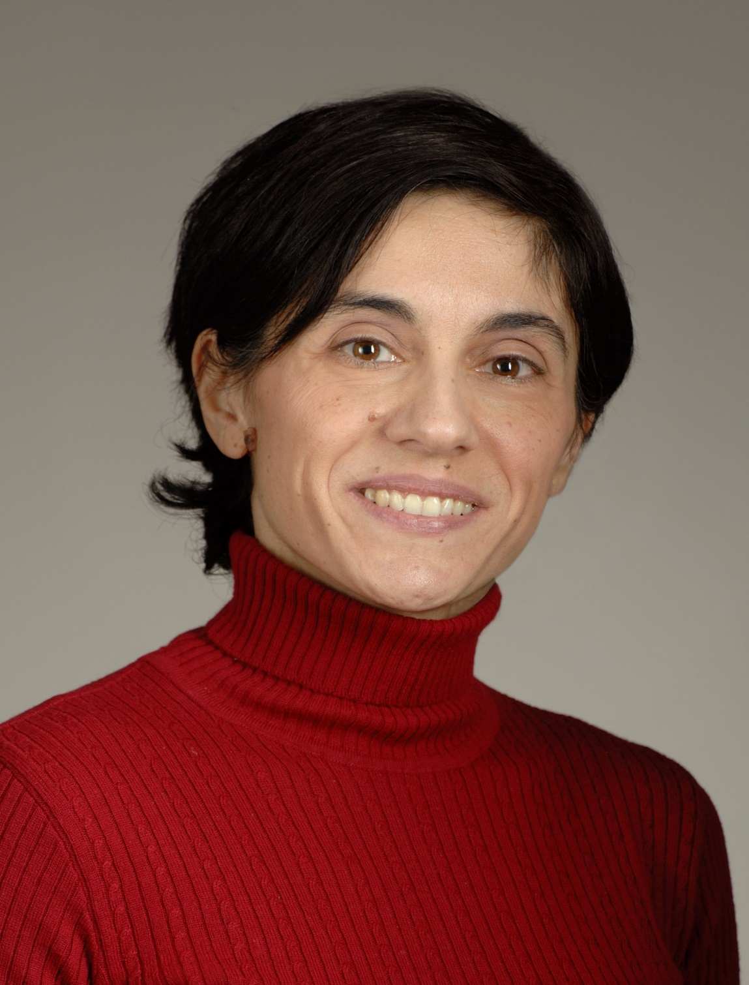
Meet Niki
Associate Scientific Director, Tenure Track/Assistant Clinical Investigator (TT/ACI) Faculty Development, Chief Oral Immunity and Infection Section, National Institute of Dental and Craniofacial Research, National Institutes of Health (NIDCR/NIH), Maryland, USA
Fields of research
Immunology, Inflammation, Microbiology
Niki leads the Moutsopoulos Lab, which studies oral mucosal immunity in health and disease.
Learn more about Niki’s work…
Dr Niki
Moutsopoulos
17

Slide 18
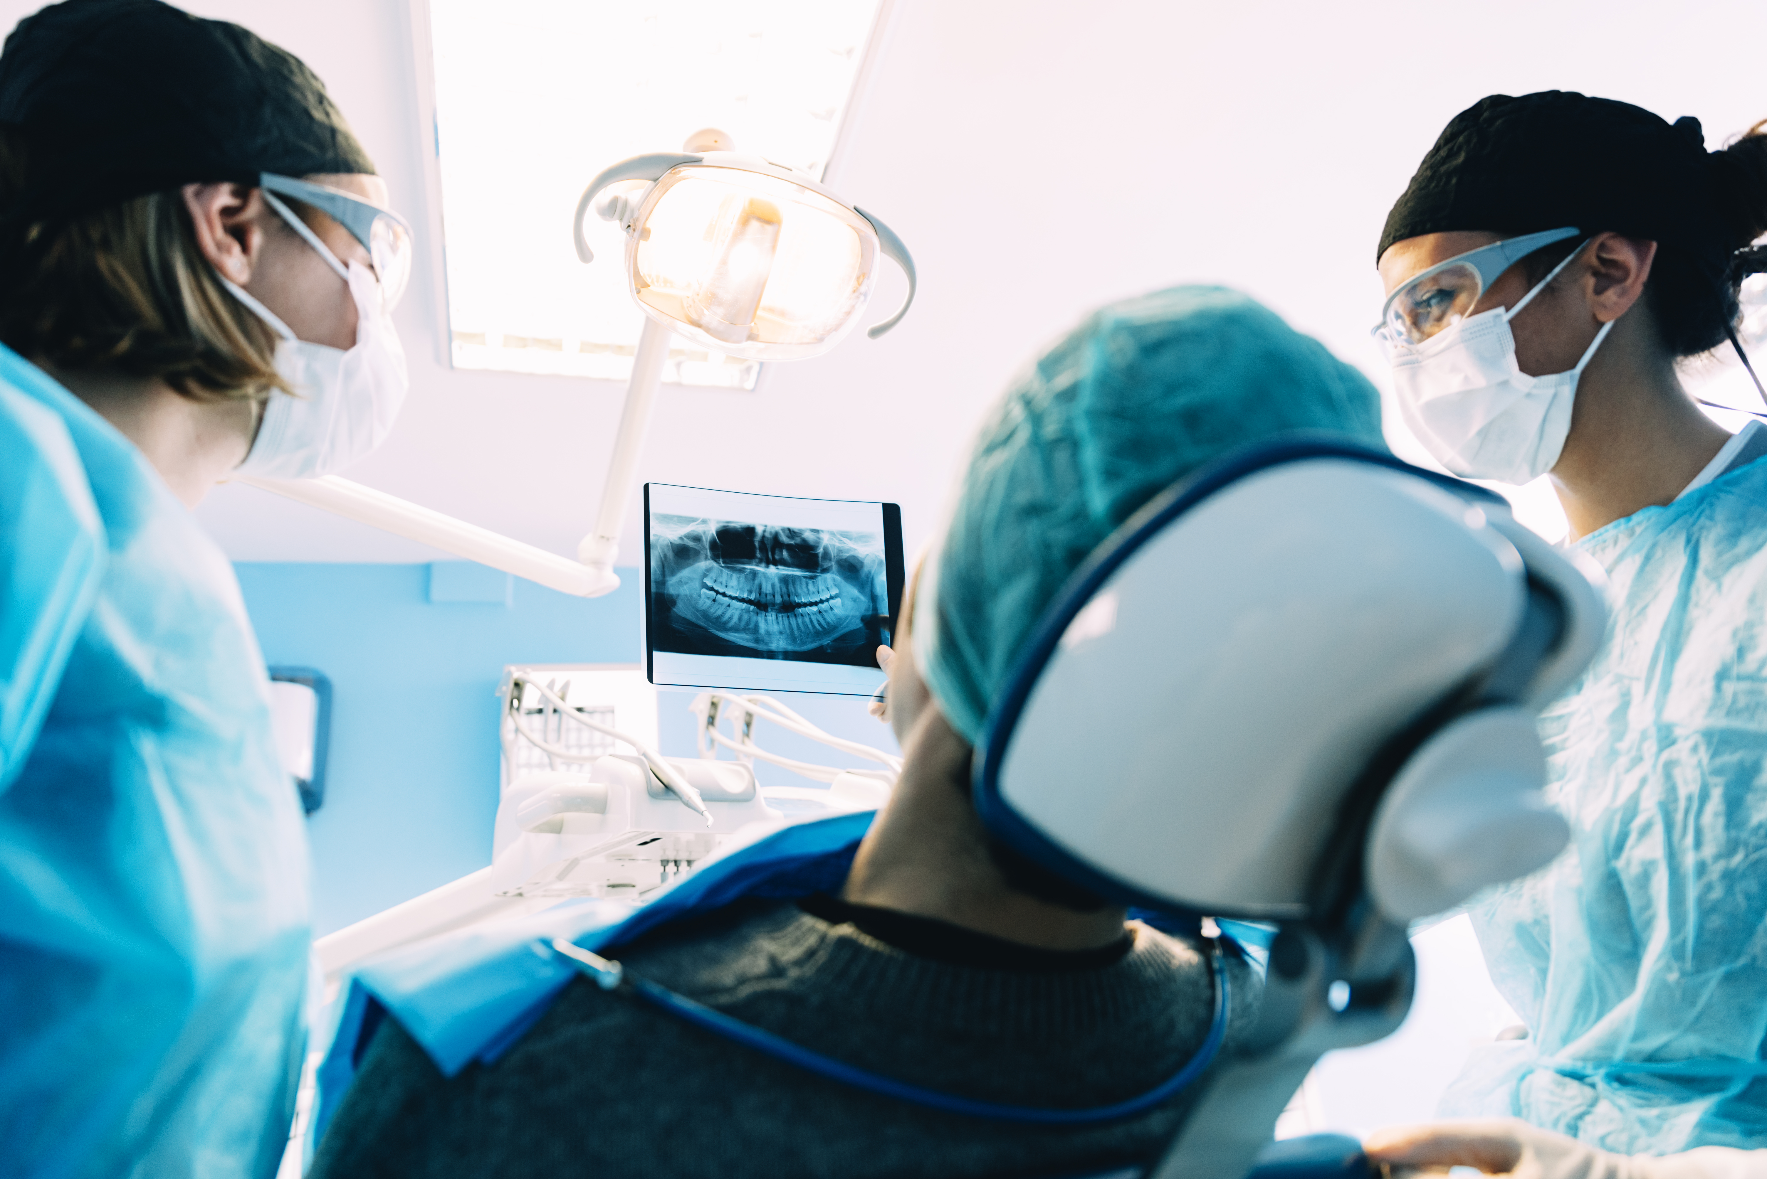
Niki’s research
“We take a bedside-to-bench approach to studying oral mucosal immunity, aiming to understand oral diseases in people and help treat them.
“Research in our lab combines many types of work, ranging from seeing patients in the clinic to performing wet lab experiments, analyzing data and applying computational approaches.
“We are thrilled that our lab has been able to partner with scientists and clinicians from many fields with the idea that diverse perspectives can help tackle complex questions in biology and medicine.”
© santypan/Shutterstock.com
18

Slide 19
Niki says…
“My top tips:
Challenge yourself and try to ask important questions.
Find mentors willing to support and push you forward.”
Dr Niki
Moutsopoulos
19

Slide 20
Talking points: Margherita, Janice, Azeez, Niki
Why do you think Margherita finds collaborating with other researchers so rewarding? How rewarding would you find it, and why?
Why is 3D computational analysis so useful for Janice’s research?
Why do you think it is important for Azeez to look at environmental factors, as well as genetics?
Niki’s bedside-to-bench approach involves treating patients (at the bedside) and then conducting research in the lab (at the bench). What do you think are the advantages of this approach?
20
© ra2 studio/Shutterstock.com

Slide 21
Researchers investigating ways to correct oral health problems…
21
© ra2 studio/Shutterstock.com

Slide 22
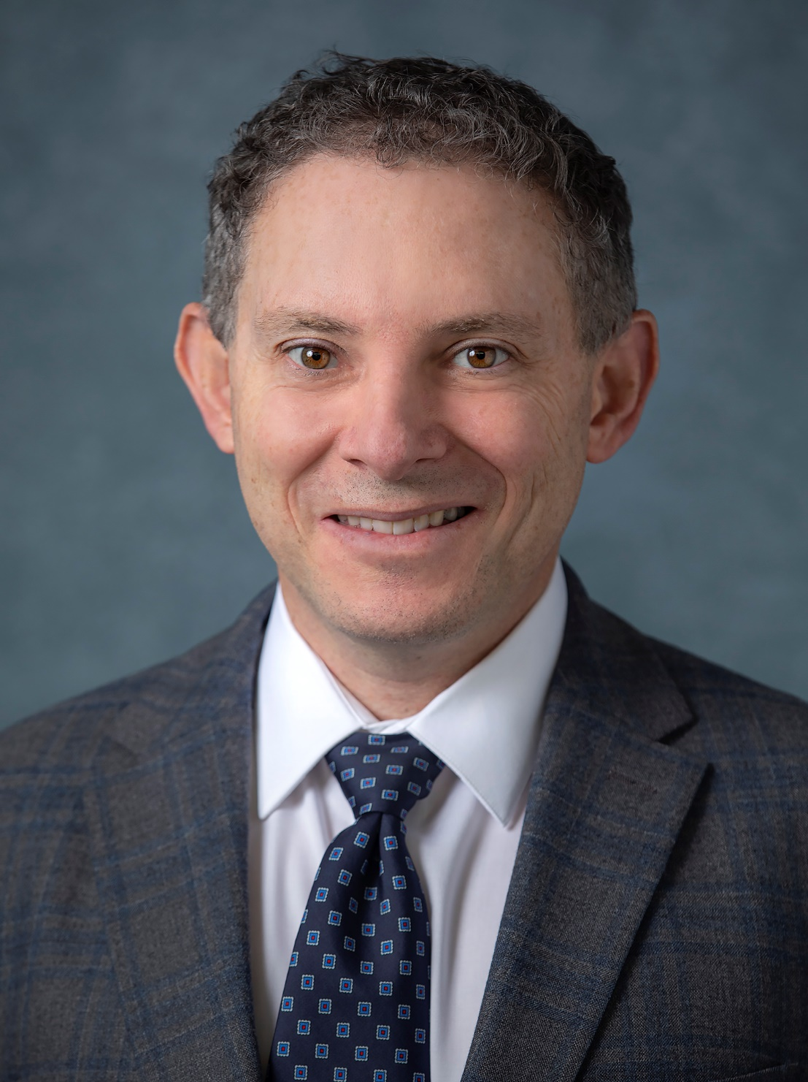
Meet Ophir
Professor of Pediatrics, Cedars Sinai, California, USA
Fields of research
Pediatrics, Medical Genetics
Ophir is a pediatrician and medical geneticist.
His research focuses on craniofacial development.
Learn more about Ophir’s work…
Professor Ophir Klein
22

Slide 23
Ophir’s research
“Our lab is studying how teeth form and how the lining of
the mouth (the oral mucosa) can heal so quickly and without scarring.
“To study craniofacial and dental birth defects, we perform a variety of studies, including using mouse and zebrafish animal models, experiments with cells derived from patients, and genetic and phenotypic analyses of the patients themselves.
“By learning how stem cells fuel both normal turnover of tissues as well as repair of injuries and other types of damage, we are laying a foundation for harnessing the regenerative power of these amazing cells and thinking about how to use them therapeutically.”
Professor Ophir Klein presenting at a conference
23

Slide 24

Ophir says…
“What one word sums up a career in medical genetics? Captivating
My top tip:
Medical and scientific training will be difficult and challenging at times, and they’ll require some sacrifices, but if you love what you’re doing, it is definitely worth it. If you can, try not to worry too much about what is going to happen in the distant future, and focus on the journey.”
Professor Ophir Klein
24

Slide 25
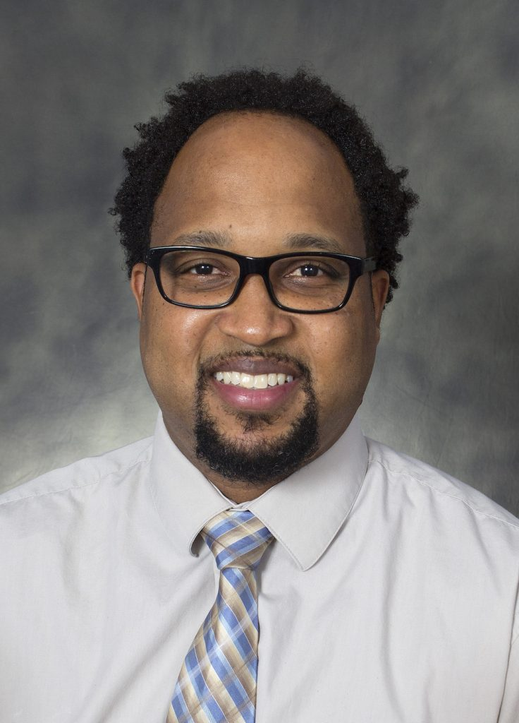
Meet Darnell
Director of Kaigler Lab, Major M. Ash Collegiate Professor of Dentistry, Department of Periodontics & Oral Medicine, Department of Biomedical Engineering, University of Michigan School of Dentistry, USA
Fields of research
Regenerative Medicine, Stem Cell Biology and Therapy
Darnell leads the Kaigler Research Group, which is focused on the development of methods to regenerate tissue.
Learn more about Darnell’s work…
Dr Darnell Kaigler
25

Slide 26
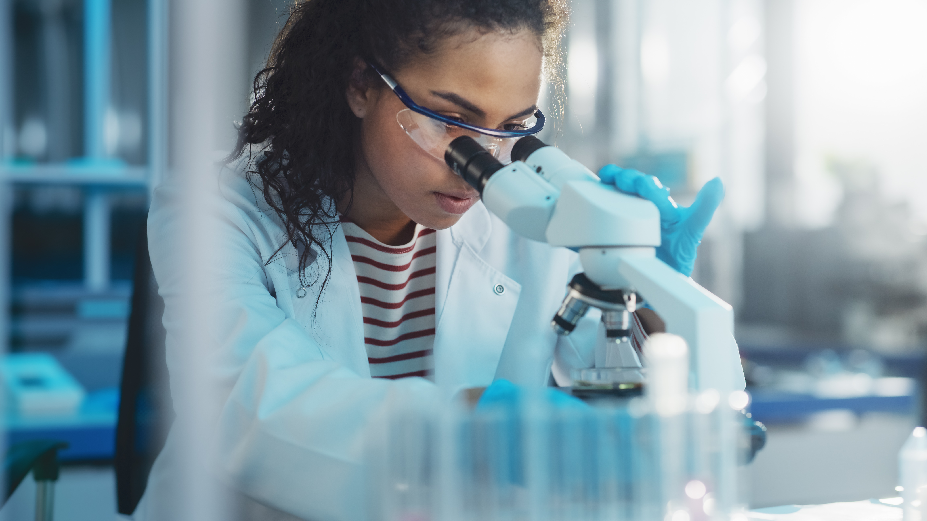
Darnell’s research
“My lab conducts research on stem cell-based therapies for the regeneration of oral tissues. We are currently trying to determine how stem cells from the body can be procured, cultivated and re-introduced to the body to repair, regenerate and reconstruct diseased and damaged tissues.
“This stem cell therapy could have great impact on people and their everyday lives by enabling treatment of debilitating conditions for which there are currently limited treatment options.
“Using stem cell therapies to successfully treat patients in our clinical trials and seeing the impact it has had on patients are highlights of my career.”
© Gorodenkoff/Shutterstock.com
26

Slide 27
Darnell says…
“What one word sums up a career in
periodontics? Awesome
My top tip:
Pick something to study that you are genuinely interested and excited to learn about.”
Dr Darnell Kaigler
27

Slide 28
Talking points: Ophir, Darnell
What is it about stem cells that interests Ophir?
What do you think are some of the challenges of medical and scientific training that Ophir mentions?
What does Darnell think reintroduced stem cells could do to damaged tissues?
What do you think are the challenges and rewards of running clinical trials like Darnell does?
28
© ra2 studio/Shutterstock.com

Slide 29
Researchers investigating wider impacts of oral health…
29 futurumcareers.com
© ra2 studio/Shutterstock.com

Slide 30
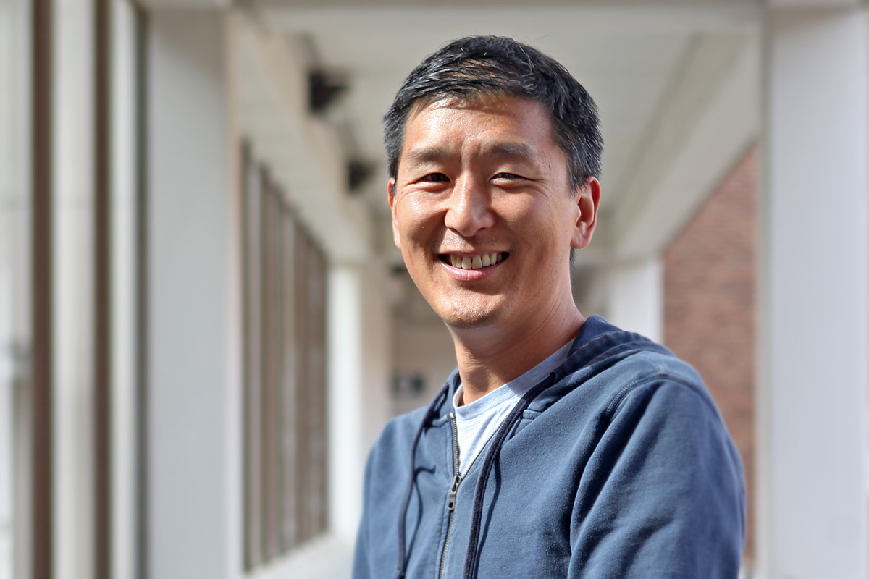
Meet Donald
Professor and Associate Dean for Research, Lloyd and Kay Champan Endowed Chair for Oral Health, School of Dentistry, University of Washington, USA
Fields of research:
Pediatric Dentistry, Health Services
Donald is a pediatric dentist whose research addresses health disparities. He works with vulnerable and marginalized communities, targeting health inequality.
Learn more about Donald’s work…
Dr Donald L. Chi
30

Slide 31
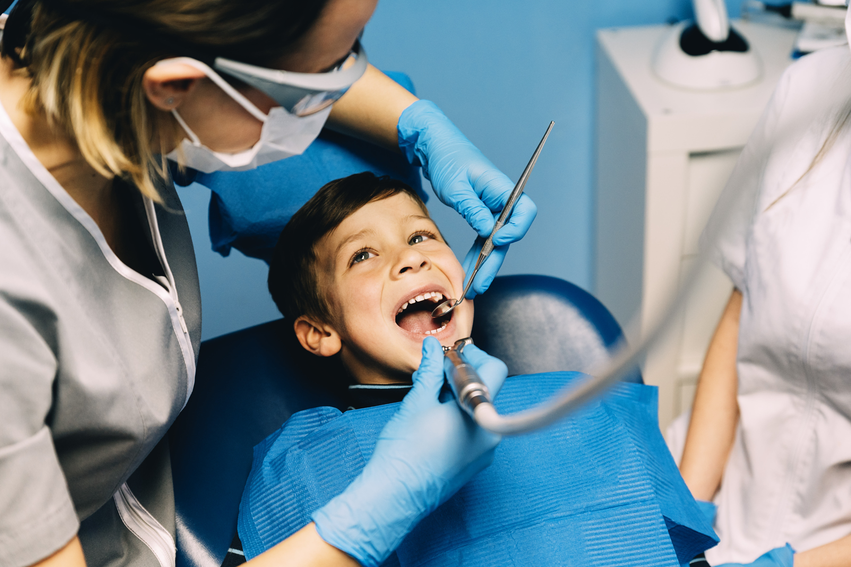
Donald’s research
“Many individuals from vulnerable communities have similar experiences. These include difficulties accessing dental care, high sugar diets, and inadequate fluoride exposure – all of which pose risks for their oral health.
“Oral health inequities in childhood can lead to pain, missing teeth, hospitalizations, systemic diseases and missed school days. These factors have lifelong consequences, many of which are irreversible.
“It’s an absolute joy working with children though pediatric dentistry. My research is aimed at breaking the disease cycle. Conducting research that has a positive impact on vulnerable families is something I am very proud of.”
© santypan/Shutterstock.com
31

Slide 32
Donald says…
“A career in pediatric dentistry summed up in one word? Opportunities
My top tip:
Hone your thinking and writing skills, read broadly, and when communicating with others, practice conveying the big picture first.”
Dr Donald L. Chi
32

Slide 33
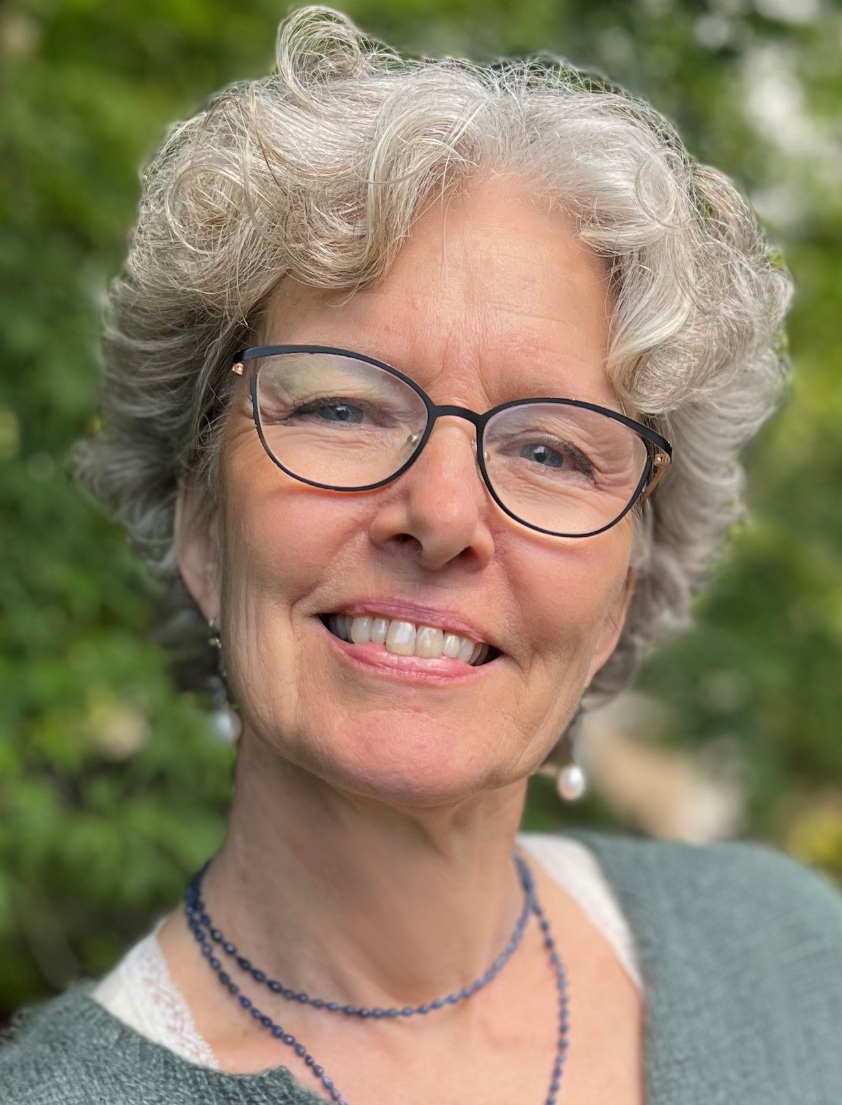
Meet Caroline
School of Dentistry, University of California San Francisco, USA
Fields of research
Orofacial Science, Oral Medicine, Epidemiology
Caroline studies how immune dysfunction can manifest in oral health problems.
Learn more about Caroline’s work…
Dr Caroline Shiboski
33

Slide 34
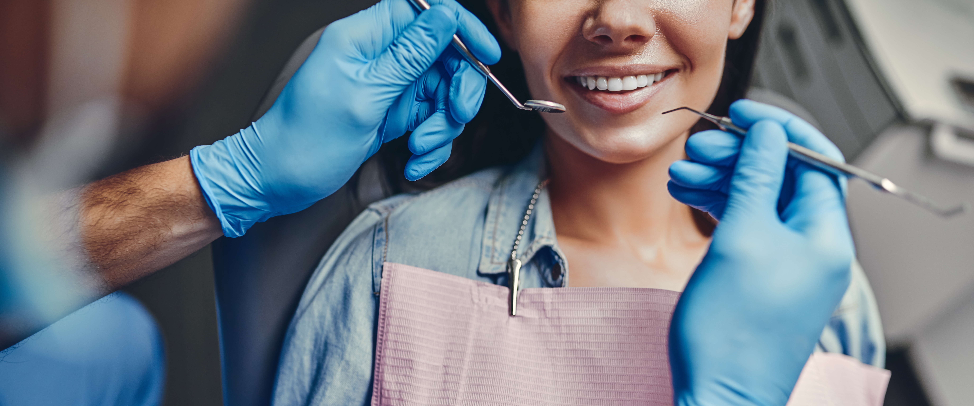
Caroline’s research
“If a person’s immune system is weak, they may develop more infections (from either bacteria, viruses or fungi), and some of these infections can happen in the mouth.
“The immune system can also be overactive, when a person has an autoimmune disease. There are many different autoimmune diseases, with each one affecting a different part of the body that is being attacked by overreactive immune cells.
“My career highlights include having the opportunity to work with multidisciplinary teams for my work in HIV (a condition where the body’s immune system is unable to fight off infection or disease), and for my work in Sjögren’s disease (a condition where the body attacks glands that secrete fluid).”
© 4 PM production/Shutterstock.com
34

Slide 35
Caroline says…
“What one word sums up a career in orofacial science? Multidisciplinary
My top tip:
Don’t get into a lot of school debt to go to graduate school too early. Explore options for scholarships, training grants, etc.”
Dr Caroline Shiboski
35

Slide 36
Talking points: Donald, Caroline
What do you think are some of the lifelong consequences for people who experience oral health inequities in childhood?
How do you think Donald aims to break the ‘disease cycle’?
How might a weakened immune system be evident in someone’s mouth?
What type of research has working in multidisciplinary teams allowed Caroline to conduct? Why do you think Caroline considers this work a career highlight?
36 futurumcareers.com
© ra2 studio/Shutterstock.com

Slide 37
Pathway from school to dental research (1/2)
A focus on biology, chemistry and mathematics in high school and college will provide a good foundation for a dental degree.
There are many opportunities to try dental research with the NIH and at colleges and universities across the US, in low and middle income countries, and elsewhere.
This website links to NIH training opportunities from high school and beyond.
37
© ra2 studio/Shutterstock.com
Notes:
website links to NIH training opportunities https://www.nidcr.nih.gov/careers-training

Slide 38
Pathway from school to dental research (2/2)
Azeez and Janice recommend the Office of Intramural Training and Education’s website for summer internships and other programs.
Jennifer highlights the huge range of fields of science that dental research involves: “Genetics, oncology, developmental biology, engineering, neuroscience, microbiology, immunology, biochemistry, physiology, public health, data science/computational biology, clinical research, and health disparities just to name a few…,” she says. The discipline that appeals to you will impact the courses you take at the college level and the path you take beyond that.
38
© ra2 studio/Shutterstock.com
Notes:
website for summer internships and other programs https://www.training.nih.gov/research-training/hs/hs-sip/

Slide 39
Explore careers in dental research
Donald suggests finding a dentist to shadow. This could be a dentist who runs a full-time practice or a dentist in an academic setting. Caroline adds how valuable it is to talk to people in the profession to hear about their work.
Margherita advises finding great mentors and joining scientifically strong groups.
39

Slide 40
Talking points: Jennifer
What do you think are some of the benefits of participating in a dentistry-focused student program? How would taking part in such a program benefit you personally?
Of the range of fields Jennifer highlights as being involved in dental research, which interest you the most, and why? Which fields do you know the least about currently, and how could you find out more?
How could you go about finding a dentist to shadow or to talk to about their profession? If you are unsure, who could you talk to at your school to help you?
Now that you know more about dental research, how likely are you to consider a career in the field, and why?
40
© ra2 studio/Shutterstock.com

Slide 41
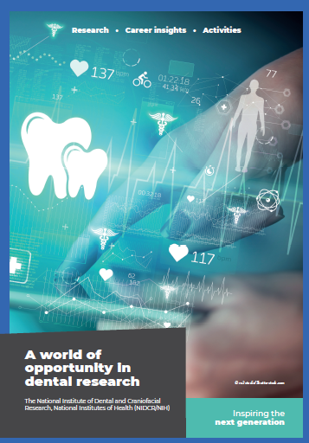
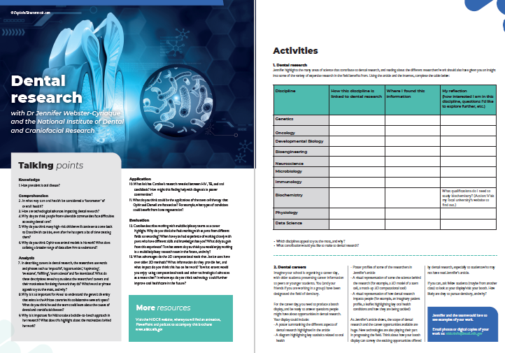


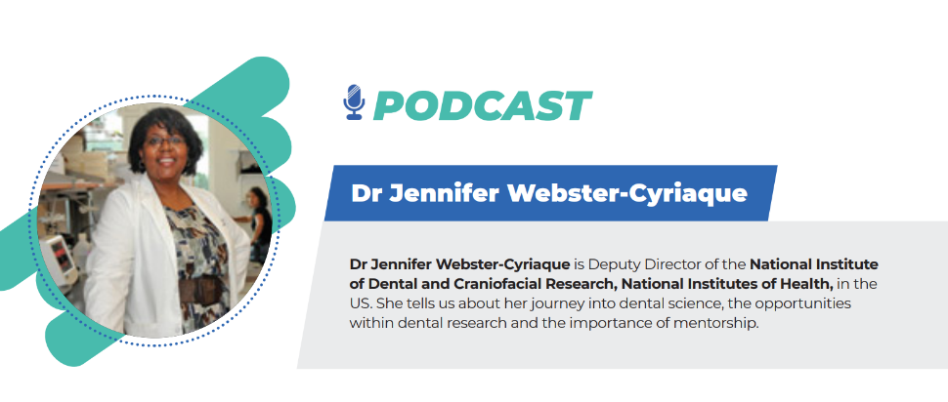
More resources
Download Jennifer’s article
Download Jennifer’s activity sheet
03
Download Jennifer’s animation
04
Download Jennifer’s
podcast
01
02
41
Notes:
Read the article (https://www.nidcr.nih.gov/careers-training/resources-high-school-educators)
Download the activity sheet (https://www.nidcr.nih.gov/careers-training/resources-high-school-educators)
Watch the animation (https://www.nidcr.nih.gov/careers-training/resources-high-school-educators)
Download the careers PowerPoint (https://www.nidcr.nih.gov/careers-training/resources-high-school-educators)

Slide 42
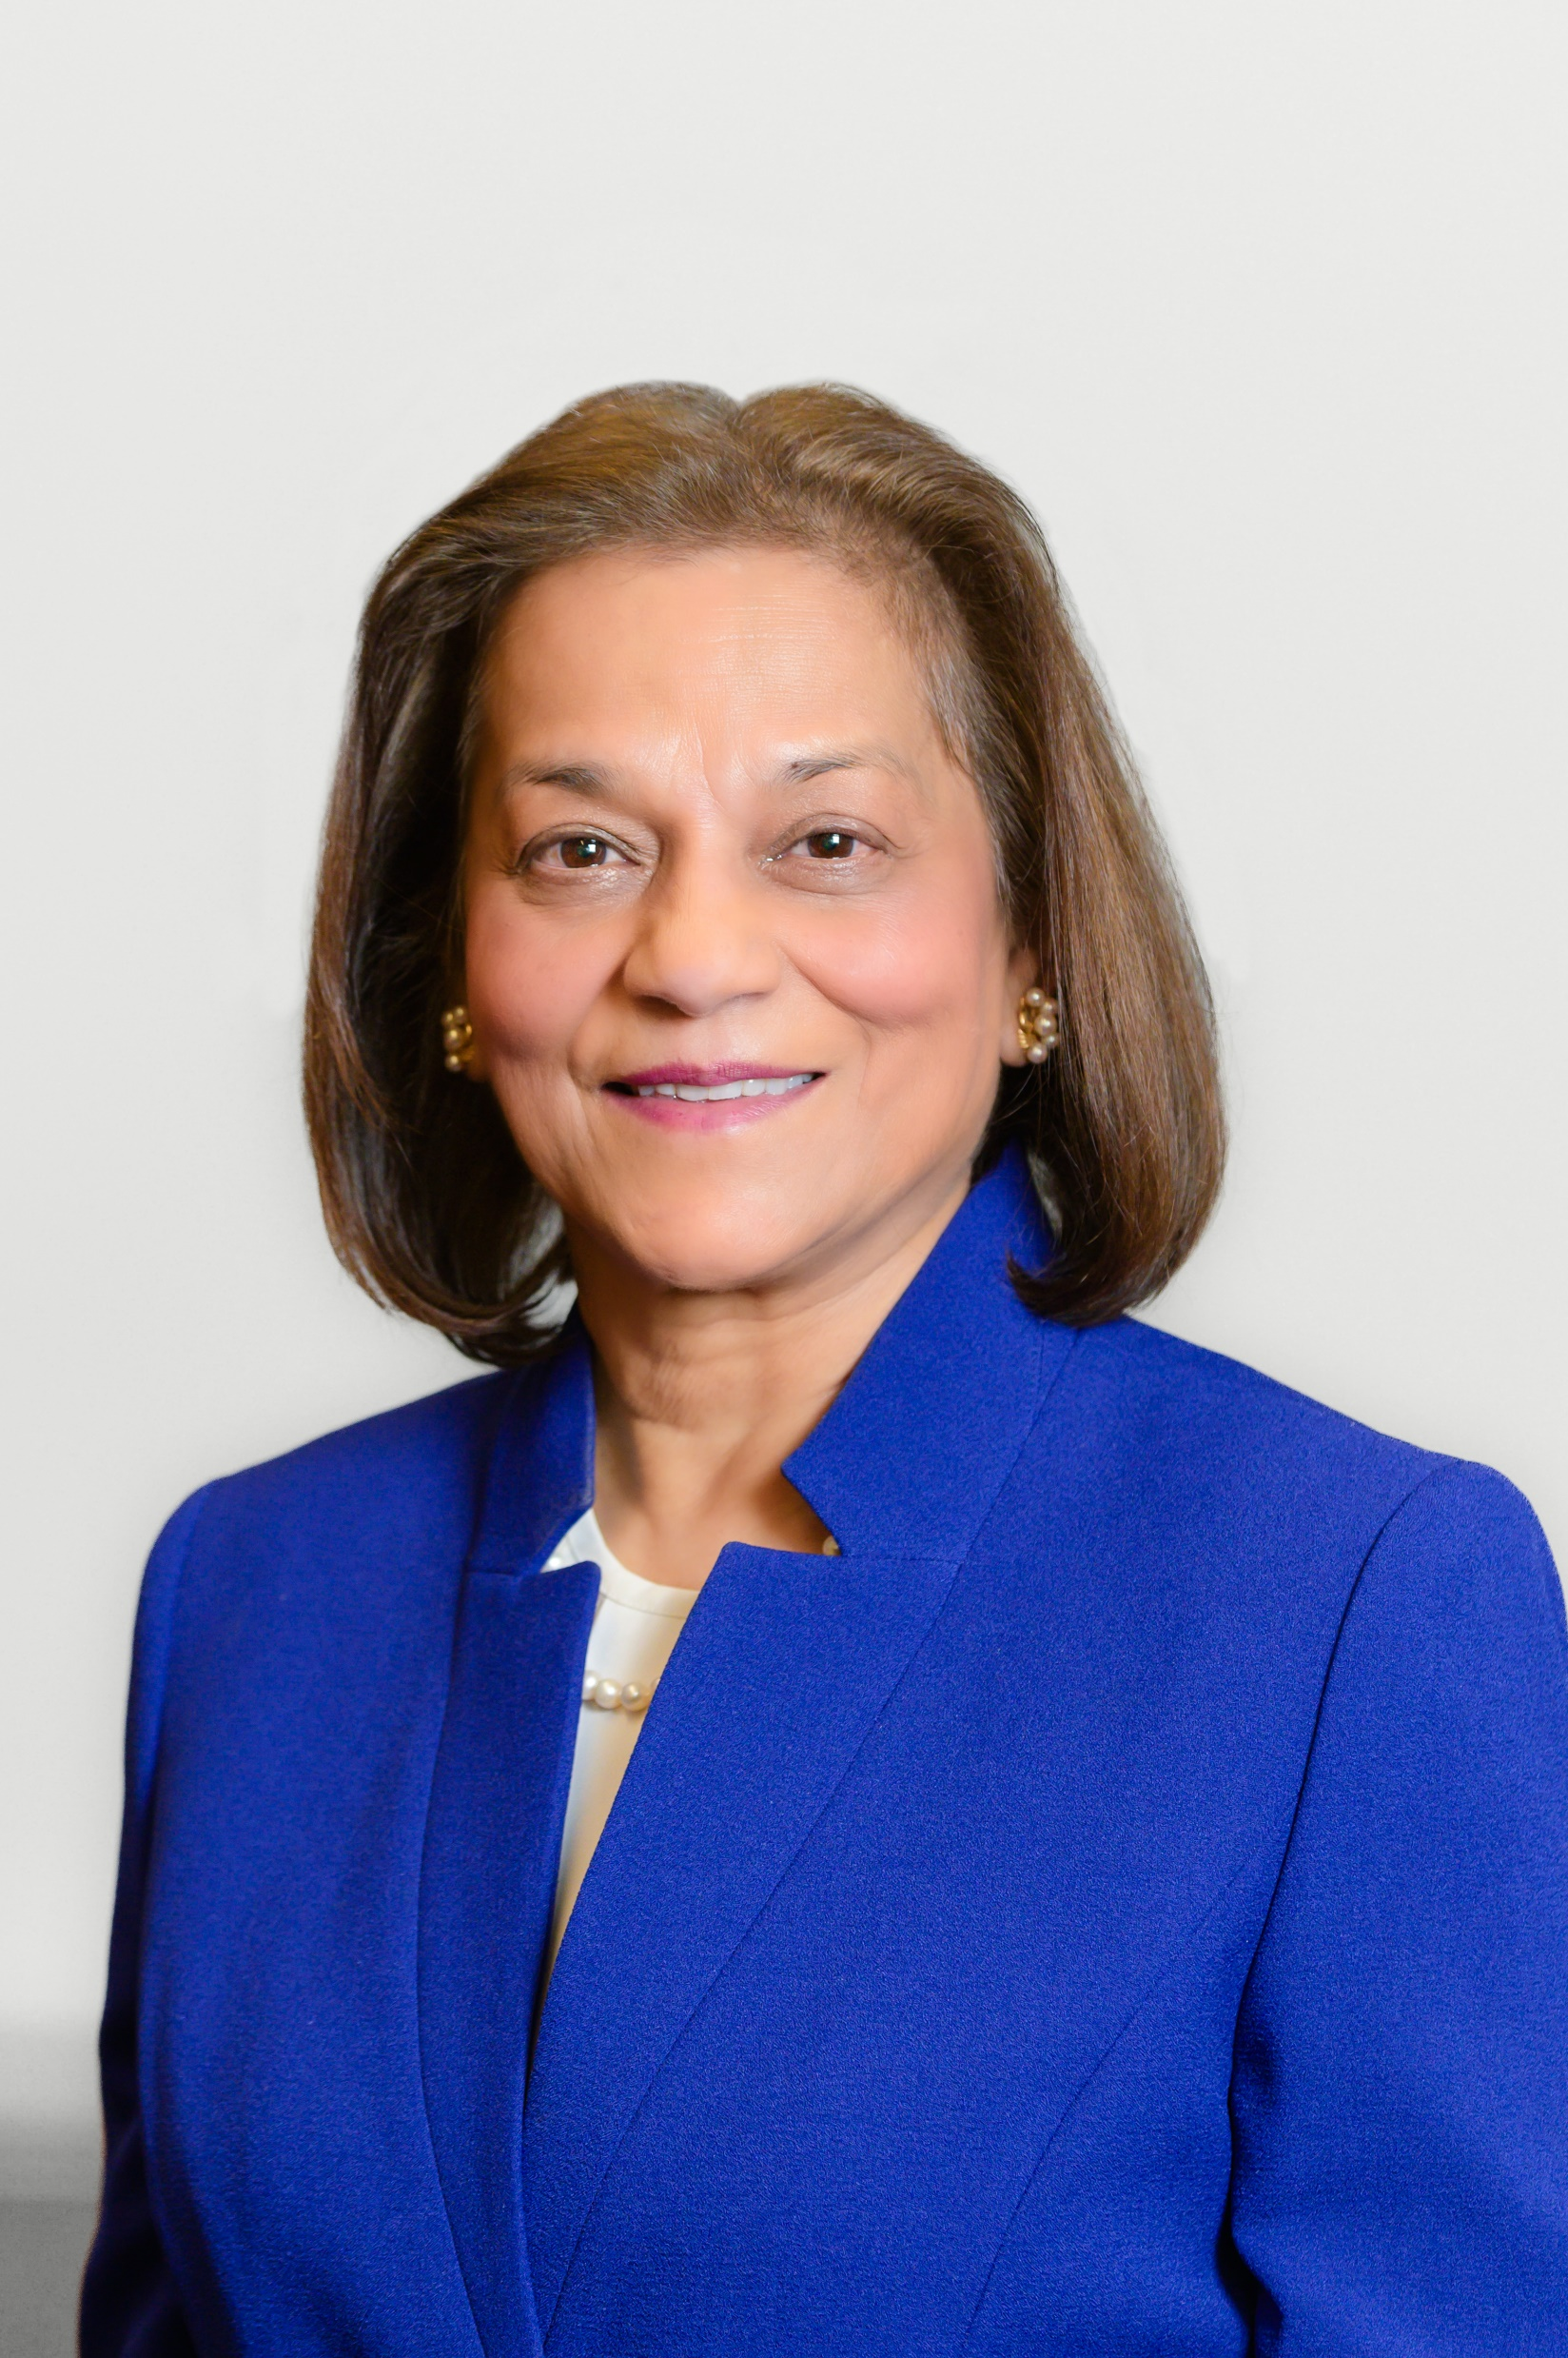
Dr Rena D’Souza
Director, National Institute of Dental and Craniofacial Research, National Institutes of Health, (NIDCR/NIH)
“Oral health is not just a nice smile; it’s an integral part of overall health, but we don’t always understand how.
Consider the face – it is our unique identifier. There is much work to do in understanding syndromes that lead to craniofacial defects and affect the face. Diligent research and innovation are also needed to reduce public health burdens caused by dental decay, periodontal disease, Sjögren’s syndrome and oral cancers.
Together, we can realize the promise of science and move towards oral health for all. Consider a rewarding career in dental research…”
42

