Slide 1



Dental Research
Dr Jennifer Webster-Cyriaque

Slide 2

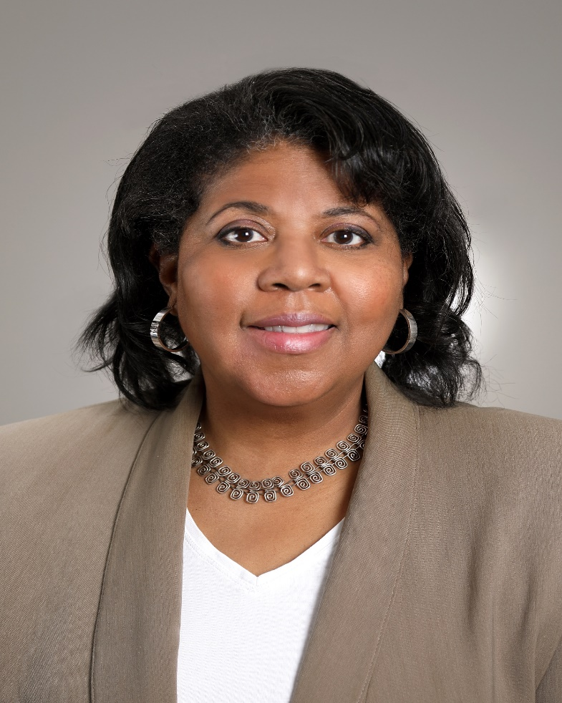
Pre-listening:
Pre-listening | Break it down | Post-listening | Learn more
Meet
Dr Jennifer Webster-Cyriaque
What do you already know about careers in dental research?
What type of research do you think a dental researcher conducts?
What skills and knowledge do you think dental research requires?
How interested are you in pursuing a career in dental research, and why?
US National Institute of Dental and
Craniofacial Research, National Institutes of Health
Fields of research:
Oral Health, Microbiology, Immunology, Virology
"Science is a team sport."

Slide 3


Break the podcast down:
Start – 04.35
Pre-listening | Break it down | Post-listening | Learn more
What range of research is being conducted by scientists at the National Institute of Dental and Craniofacial Research, National Institutes of Health?
What research fields contribute to dental research?
Why do you think Jennifer describes science as a team sport? To what extent do you agree with this description, and why?
Jennifer says that if you have a question, you are a scientist. What questions do you have? How would you go about investigating possible answers?

Slide 4

Break the podcast down:
04.45 – end
Pre-listening | Break it down | Post-listening | Learn more
In what way did Jennifer find dentistry more gratifying than medicine?
How have mentors impacted Jennifer’s career?
Why is listening to different perspectives so important for science?
Jennifer gives several pieces of advice. Which advice do you find the most useful, and why? What could you do now to act upon Jennifer’s advice?

Slide 5

Post-listening:
Pre-listening | Break it down | Post-listening | Learn more
How would you describe what a dental researcher does
to someone who has not listened to Jennifer’s podcast?
Which skills and knowledge does dental research require?
To what extent do you have these skills? Which skills do you need to develop further?
What did Jennifer say that you had not expected her to say?
What have you learned about being a dental researcher that you did not know before?
What further questions would you ask Jennifer about dental research and/or her career?
Now that you have heard Jennifer talk, how interested are you in dental research, and why?

Slide 6


Learn more about dental research:
Pre-listening | Break it down | Post-listening | Learn more
Read the article
Watch the animation
Download the activity sheet
Download the careers PowerPoint
Notes:
Read the article (https://www.nidcr.nih.gov/careers-training/resources-high-school-educators)
Watch the animation (https://www.nidcr.nih.gov/careers-training/resources-high-school-educators)
Download the activity sheet (https://www.nidcr.nih.gov/careers-training/resources-high-school-educators)
Download the careers PowerPoint (https://www.nidcr.nih.gov/careers-training/resources-high-school-educators)

